Slide 1

Object Oriented Design & Programming (21CSC101T)
Arvind Kharwal

Slide 2
Package Diagram

Slide 3
Package diagrams are structural diagrams used to show the organization and arrangement of various model elements in the form of packages.
A package is a grouping of related UML elements, such as diagrams, documents, classes, or even other packages.
Each element is nested within the package, which is depicted as a file folder within the diagram, then arranged hierarchically within the diagram.
Package diagrams are most commonly used to provide a visual organization of the layered architecture within any UML classifier, such as a software system.

Slide 4
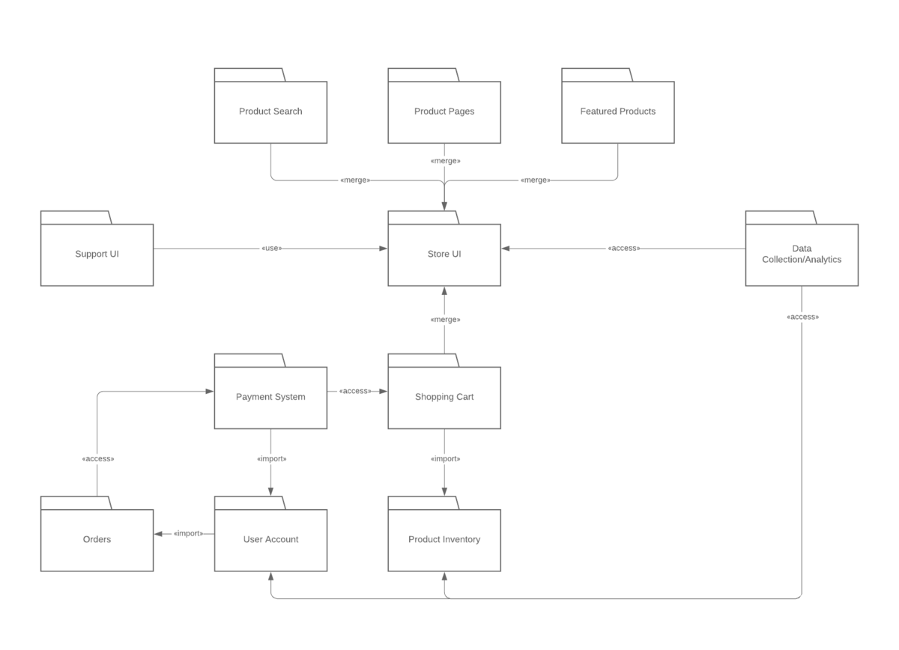

Slide 5
Benefits of a package diagram

Slide 6
A well-designed package diagram provides numerous benefits to those looking to create a visualization of their UML system or project.
They provide a clear view of the hierarchical structure of the various UML elements within a given system.
These diagrams can simplify complex class diagrams into well-ordered visuals.
They offer valuable high-level visibility into large-scale projects and systems.
Package diagrams can be used to visually clarify a wide variety of projects and systems.
These visuals can be easily updated as systems and projects evolve.

Slide 7
Basic components of a package diagram

Slide 8
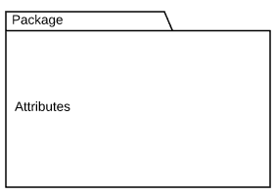
The makeup of a package diagram is relatively simple. Each diagram includes only two symbols:
Name: Package
Description:Groups common elements based on data, behavior, or user interaction

Slide 9

Dependency
Depicts the relationship between one element (package, named element, etc) and another

Slide 10
These symbols can be used in a variety of ways to represent different iterations of packages, dependencies, and other elements within a system. Here are the basic components you’ll find within a package diagram:
Package: A namespace used to group together logically related elements within a system. Each element contained within the package should be a package able element and have a unique name.

Slide 11
Package able element: A named element, possibly owned directly by a package. These can include events, components, use cases, and packages themselves. Package able elements can also be rendered as a rectangle within a package, labelled with the appropriate name.
Dependencies: A visual representation of how one element (or set of elements) depends on or influences another. Dependencies are divided into two groups: access and import dependencies.

Slide 12
Element import: A directed relationship between an importing namespace and an imported packageable element. This is used to import select individual elements without resorting to a package import and without making it public within the namespace.
Package import: A directed relationship between and importing namespace and an imported package. This type of directed relationship adds the names of the members of the imported package to its own namespace.

Slide 13
Package merge: A directed relationship in which the contents of one package are extended by the contents of another. Essentially, the content of two packages are combined to produce a new package.

Slide 14
Dependency notations in a package diagram:
Package diagrams are used, in part, to depict import and access dependencies between packages, classes, components, and other named elements within your system. Each dependency is rendered as a connecting line with an arrow representing the type of relationship between the two or more elements.

Slide 15
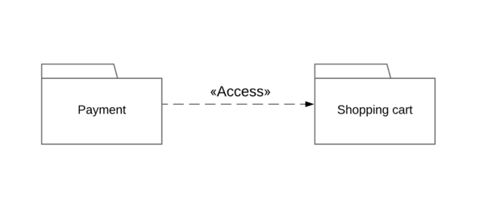
There are two main types of dependencies:
Access: Indicates that one package requires assistance from the functions of another package.
Example:

Slide 16
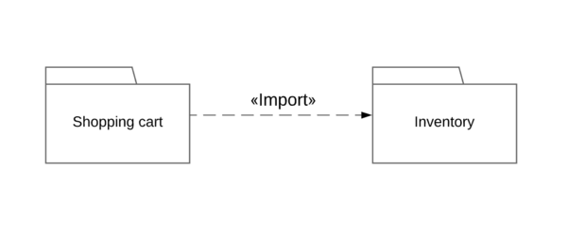
Import: Indicates that functionality has been imported from one package to another.
Example:

Slide 17
Dependencies can also be broken down further into the following categories:
Usage: Occurs when a given named element requires another for its full definition and deployment. Example: client and supplier.
Abstraction: Relates two elements representing the same concept at different levels of abstraction within the system (usually a relationship between client and supplier).
Deployment: Depicts the deployment of an artifact to a deployment target.

Slide 18
Purpose of Package Diagrams:
Package diagrams are used to structure high level system elements. Packages are used for organizing large system which contains diagrams, documents and other key deliverables.
Package Diagram can be used to simplify complex class diagrams, it can group classes into packages.
A package is a collection of logically related UML elements.
Packages are depicted as file folders and can be used on any of the UML diagrams.

Slide 19
Thank You

